Slide 1
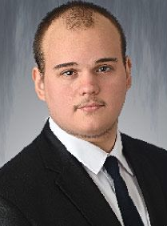

Store Register software
Budapesti Gazdasági SZC Logisztikai és Kereskedelmi Technikum és Szakképző Iskola
Developed by Vendel Hummel and Róbert Emánuel Hunka

Slide 2

The problem
The solution
• difficulty tracking products, supplier and employee data
• expensive software licenses
• affordable all-in-one software
• seamless integration
• additional features
• reduces everyday mistakes
Notes:
• The project aims to develop an efficient web-based inventory management system for small and medium businesses, solving the challenges of tracking products, suppliers, and transactions.
- Additional features do to efficient integration.

Slide 3
Key features
Basic login system for both platforms
Full data manipulation for products
Functional cashier register software to manage transactions
Valuable insights to transactions and other data through charts
Exportable receipts at checkouts

Slide 4
The program
Backend – Node.js with Express.js
• RESTful API endpoints
• Middleware for authentication
• Server-side data validation
Frontend – JavaScript, CSS
• Dynamic product cards
• Interactive forms for CRUD operations
• Desktop App - Windows Froms .NET Framework
• Cashier register software
• Create transactions and upload it to the database
• Export receipts
Database – MySQL

Slide 5
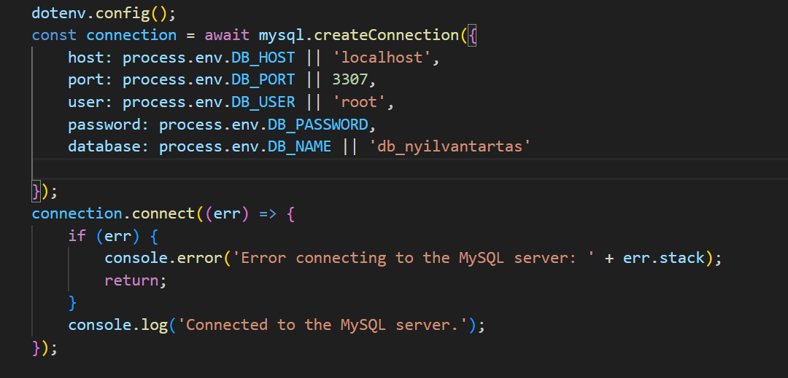
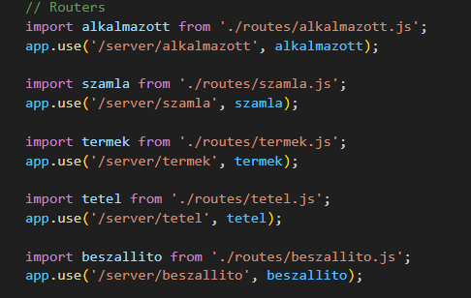
Backend
Node.js with Express.js
• RESTful API endpoints
• Middleware for authentication
• Server-side data validation

Slide 6
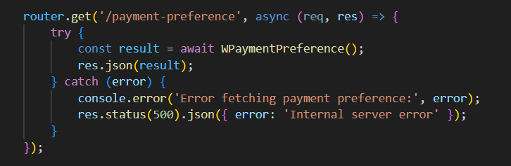
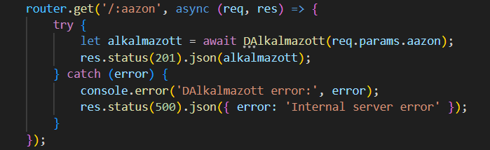
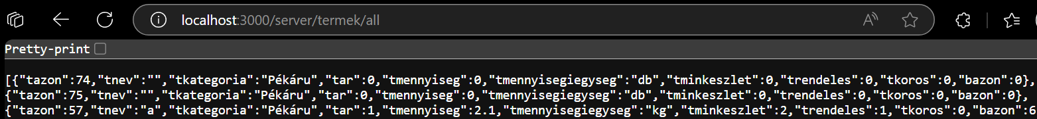
Routers
Router for each entity
/server prefix
Async functions
Only Express.js, with middlewares

Slide 7
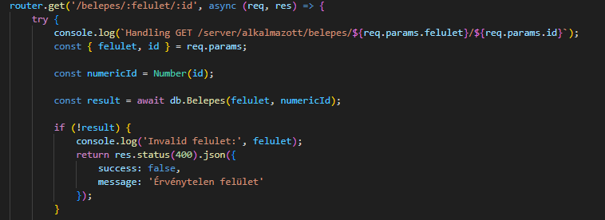
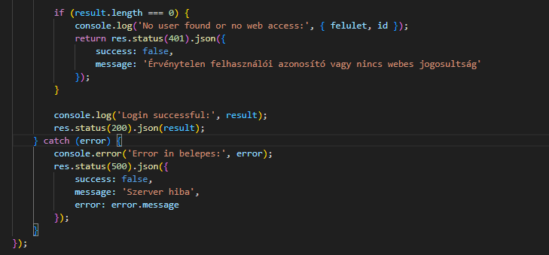
Login router

Slide 8
Detailed Endpoints explanation
Endpoint | HTTP Method | Purpose | Router file
/server/termek/all | GET | Retrieves all products | termek.js
/server/termek | POST | Creates a new product | termek.js
/server/termek/:tazon | PUT | Updates a product by ID | termek.js
/server/termek/:tazon | DELETE | Deletes a product by ID | termek.js
server/szamla/:sazon | DELETE | Deletes transaction | szamla.js
/server/szamla/monthly-sales | GET | Gets the sum of sales each month from the past 12 months | szamla.js

Slide 9
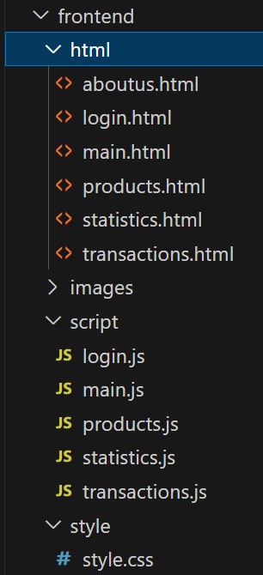
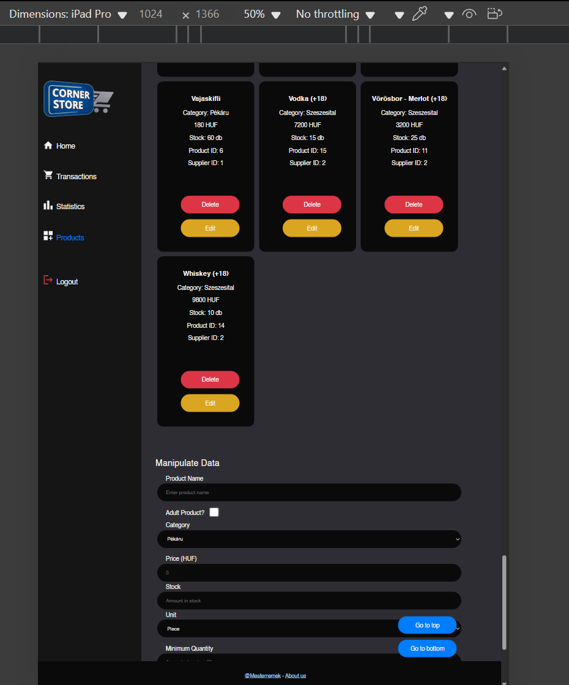
Frontend
Frontend – JavaScript, CSS
Modern CSS with responsiveness in mind
Interactive forms for CRUD operations
Dynamic product cards

Slide 10
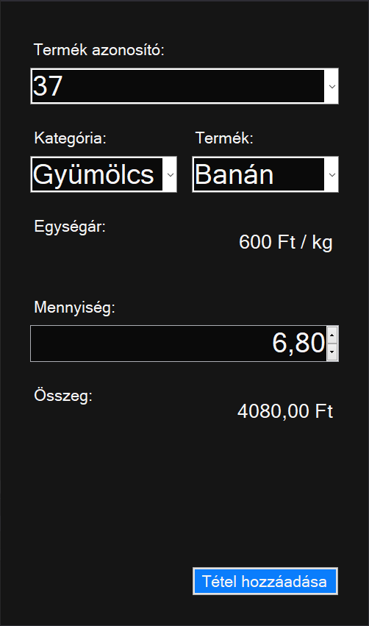
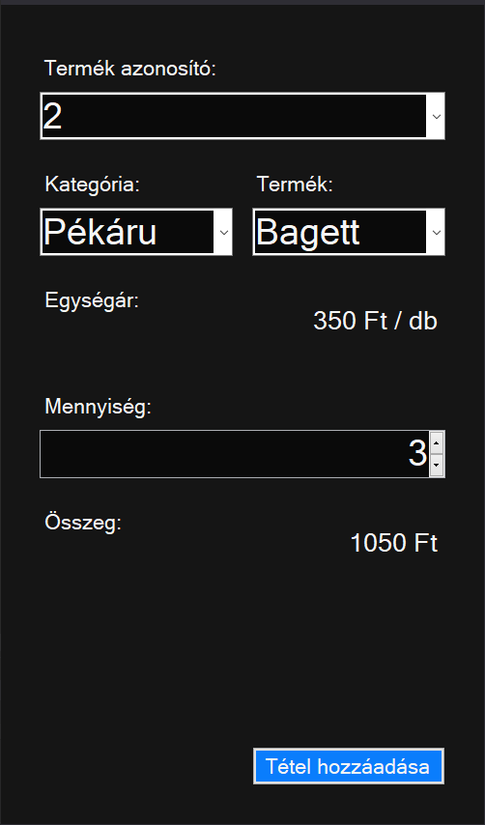
Desktop
Windows Froms .NET Framework
Record transactions from costumers
Receipt generation
User-friendly design
Login system

Slide 11

Database
MySQL based
Includes:
Employees, products, transactions, etc.
6 tables

Slide 12
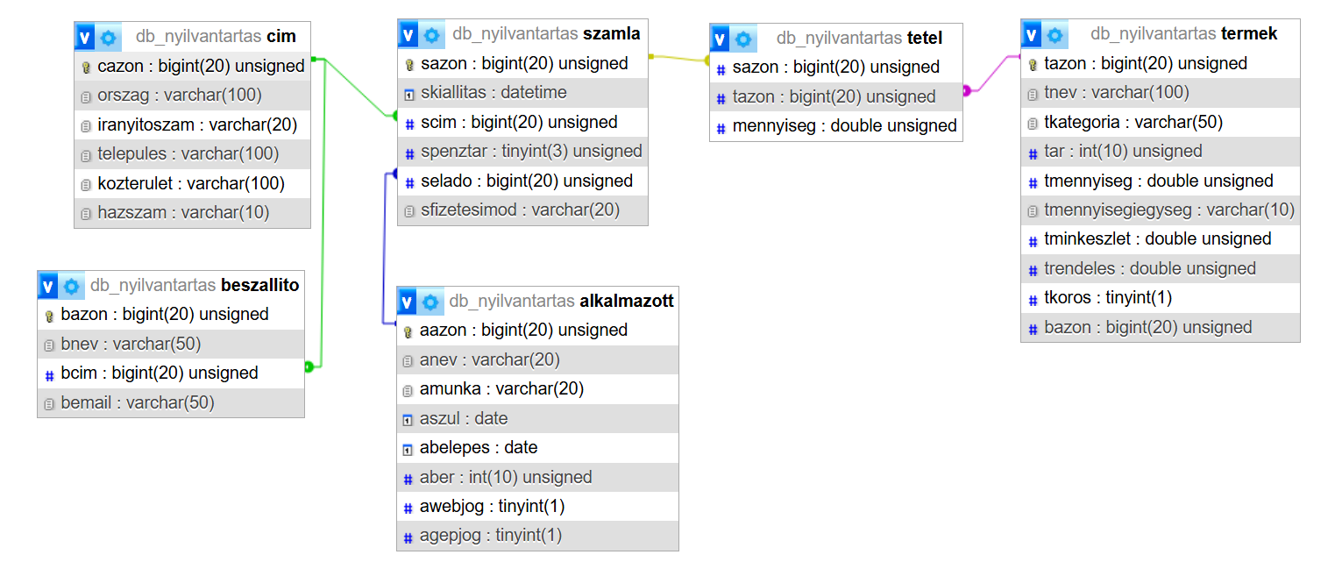
t
db_nyilvantartas.sql

Slide 13
Tests performed
API Endpoint Tests
Tested all the endpoints to ensure it retrieves all data correctly, checking for proper data formatting and response status (200 OK).
Frontend Functionality Tests
Tested the web interface’s product management by adding, editing, and deleting products through the form, ensuring the UI updates and notifications (e.g., "Product updated successfully") appear correctly.
Forms testing
Tested form submissions to ensure data is correctly formatted and compatible with the MySQL database (e.g., proper data types, required fields).
Performance and Usability Tests
Tested the system with a large dataset (e.g., 100+ items from receipts) to ensure the web interface and API responses remain fast and responsive.
Conducted usability tests on both platforms, ensuring the UI is intuitive for adding products, processing sales, and viewing data insights simultaneously

Slide 14
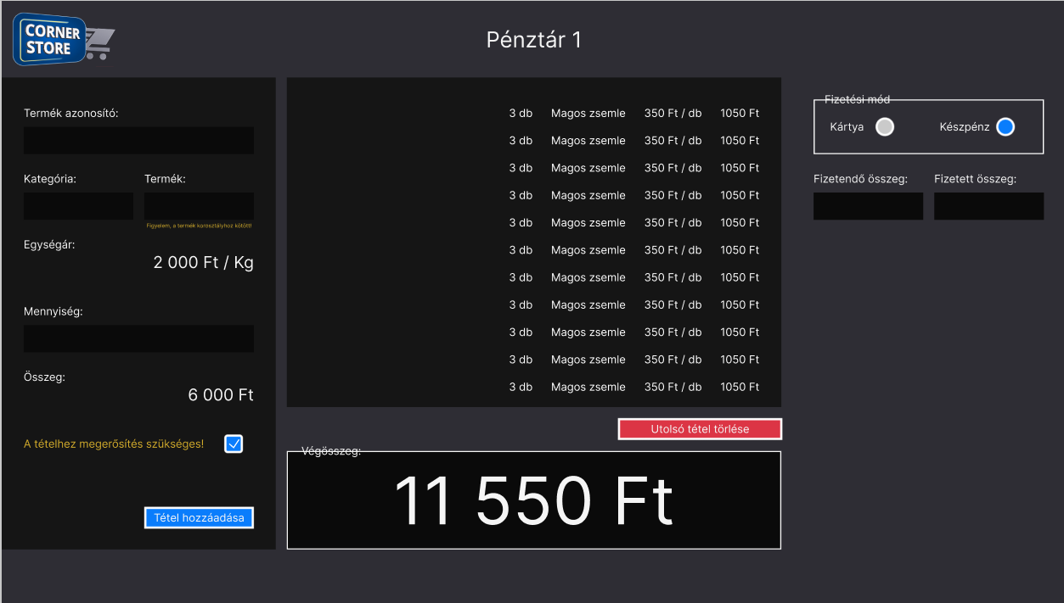

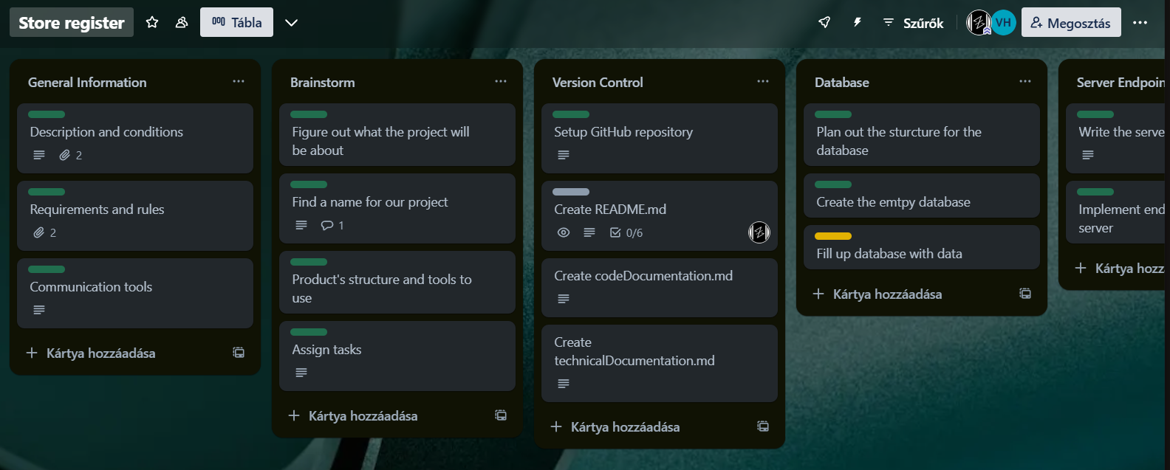

General Teamwork
The core idea
Assigning tasks
Backend Endpoints
Documentation
Our tools:
GitHub (publication + version control)
Discord and Microsoft Teams
Figma
Trello

Slide 15
The future
Export statistics
2. Admin panel
3. Complete transactions data manipulation
4. Multi-language support for a broader audience

Slide 16
Thank you for your attention!
Special thanks to our vocational teacher Sandor Boros.

Slide 17
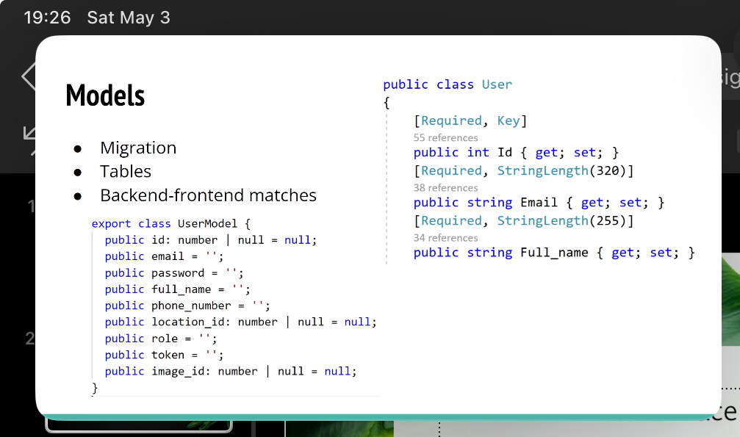
Models?

